Slide 1


Intelligent Lecture Notes Assistant
An AI-Powered Study Companion using Retrieval-Augmented Generation (RAG)
Team 5 Groq • LangChain • FAISS

Slide 2


PRESENTATION OUTLINE
Introduction & Problem Statement
Working Methodology & Implementation
Project Overview & Objectives
Results & Demo Screenshots
Key Features & Tech Stack
Applications & Advantages
System Architecture
Future Scope & Conclusion

Slide 3


PROBLEM STATEMENT
The Challenges
Proposed Solution
Searching notes is time-consuming
Develop an AI-powered assistant that understands lecture notes and provides accurate, context-aware answers using RAG technology.
Traditional search lacks context
Revision is often inefficient
Limited interactive study support

Slide 4


PROJECT OVERVIEW
The Intelligent Lecture Notes Assistant is a Streamlit-based web application designed to bridge the gap between static PDFs and active learning.
Upload and process lecture PDFs
Natural language Q&A
Instant summary & quiz generation
Context-driven AI responses

Slide 5
PROJECT OBJECTIVES
AI Assistant: Build a high-performance study tool for students.
Efficiency: Improve learning speed using RAG-based retrieval.
Time Reduction: Minimize hours spent searching through lengthy notes.
Context Awareness: Ensure responses are derived directly from course materials.
Enhancement: Provide automated flashcards, quizzes, and summaries.

Slide 6











KEY FEATURES
PDF Upload
AI Q&A
Summaries
Seamless ingestion of lecture materials.
Semantic answers via Groq LLM.
Instant breakdown of complex topics.
Quiz/MCQ
Flashcards
FAISS Search
Auto-generated practice tests.
Revision aids for active recall.
Ultra-fast semantic vector retrieval.

Slide 7
TECHNOLOGY STACK
Technology | Purpose
Python | Core programming language for backend logic.
Streamlit | User-friendly web interface and UI components.
LangChain | Orchestration framework for the RAG pipeline.
FAISS | Vector database for high-speed similarity search.
HuggingFace | State-of-the-art text embeddings generation.
Groq LLM | High-speed inference for response generation.

Slide 8








SYSTEM ARCHITECTURE
User Input
Processing
Vector DB
LLM Engine
Uploads PDF & asks questions.
Extraction, Chunking & Embeddings.
FAISS retrieves relevant context.
Groq generates the final response.
Context is retrieved dynamically before LLM generation for maximum accuracy.

Slide 9
WORKING METHODOLOGY
Upload
Extract
Chunk
Embed
Store
Retrieve
Generate
Ingest PDF
PyPDFLoader
Text Splitting
Vectors
FAISS DB
Similarity
Groq LLM

Slide 10


IMPLEMENTATION DETAILS
PDF & Text Pipeline
AI Retrieval Engine
PyPDFLoader: Parses document structure.
Semantic Mapping: Connects queries to document chunks.
Recursive Splitting: Optimizes chunk sizes for RAG.
Groq Integration: Sub-second inference speeds.
Pre-processing: Removes noise from extracted text.
Hallucination Check: Grounded in context.

Slide 11



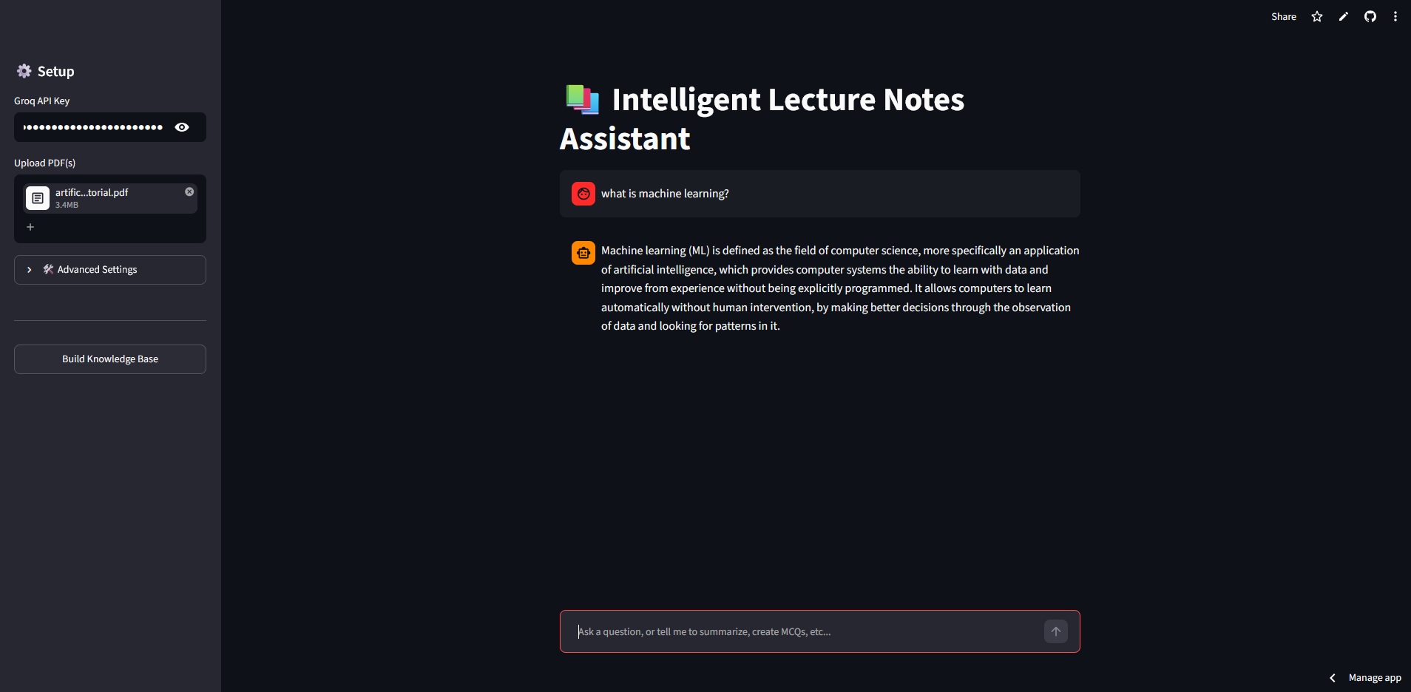


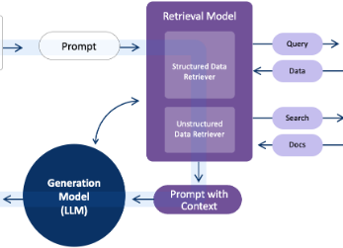
DEMONSTRATION RESULTS
Smart Quizzes
Interface
Q&A Engine
Outcome: Fast, accurate, and interactive study assistance.

Slide 12





APPLICATIONS & BENEFITS
Education
Time Saver
Self-Learning
Perfect for college students and smart digital learning.
Reduces preparation time for exams and vivas.
Empowers students with personalized study plans.
Interactive Learning: Moving from passive reading to active AI engagement.

Slide 13
FUTURE SCOPE
Voice Assistant Integration
Progress Tracking
OCR for Scanned Documents
Cloud Deployment
Multiple PDF Support
Mobile Application
Multi-language Support
Auto Study Plans

Slide 14

The Intelligent Lecture Notes Assistant leverages RAG to transform traditional notes into an interactive AI-powered ecosystem. It enables faster, more accurate, and context-aware study support for the modern student.
Questions?
Thank you for your attention!
Presented by Team 5 • 2024

Slide 15




IMAGE SOURCES
https://images.ctfassets.net/lzny33ho1g45/3x94Kjg8z9fN0zryKetKbf/a197e626de8b9035f0604ee212722f03/best-ipad-note-taking-apps.jpg?fm=jpg&q=31&fit=thumb&w=1520&h=760
Source: zapier.com
https://multipurposethemes.com/wp-content/uploads/2026/02/EduAdmin-Templates.jpg
Source: multipurposethemes.com
https://fastly.mwm-storage.mwmcdn.com/raw_files/557ff679-694b-42bc-8fe0-61413e9fbc32?height=256&format=webp
Source: mwm.ai
https://www.k2view.com/hs-fs/hubfs/RAG%20diagram%20for%20data%20readiness.png?width=1405&height=620&name=RAG%20diagram%20for%20data%20readiness.png
Source: www.k2view.com

